Slide 1
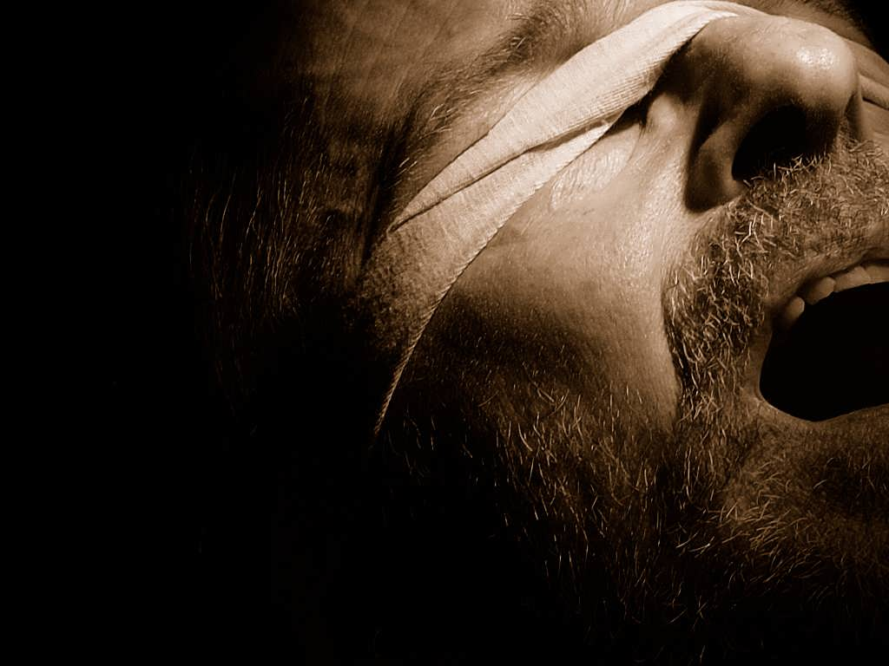



the bondage of
Cults and Isms
Fringy, Fallacius & False
A free CD of this message will be available following the service
It will also be available for podcast later this week at calvaryokc.com

Slide 2
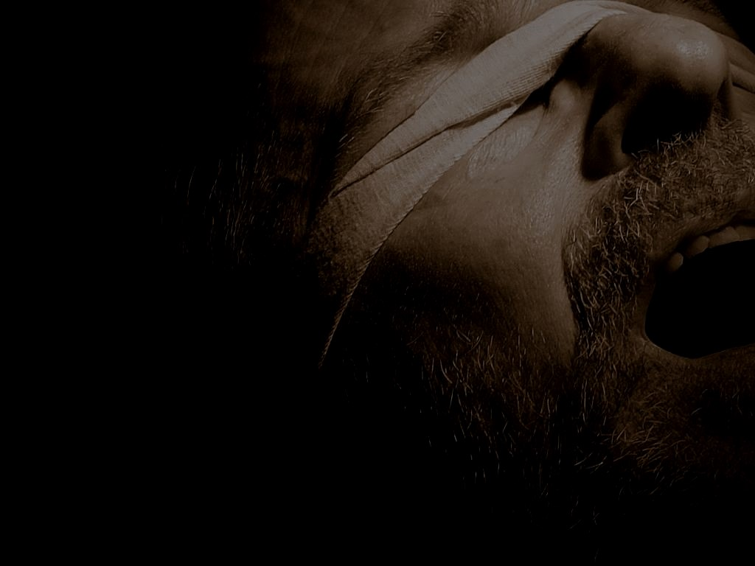
1. Who Jesus is (The God-Man - 1 John 4:3)
2. What Jesus did (Salvation by grace through faith - Gal. 1:8)
3. The Resurrection (Bodily, physical resurrection - 1 Cor. 15:17)
the bondage of Fringe
the

Slide 3
Sound Doctrine
False Doctrine
Truth-o-meter
What I believe
Things I disagree with
Aberrant beliefs
Heresy
the bondage of Fringe
the

Slide 4
the bondage of Fringe
the

Slide 5

Roman Catholicism
the bondage of Fringe
the

Slide 6
the bondage of Fringe
the

Slide 7
Third Ecumenical Council ~ AD 431
Mary received the title of Theotokos (“the God-bearer”)
Nestorius, archbishop of Constantinople, preferred Christotokos
the bondage of Fringe
the

Slide 8
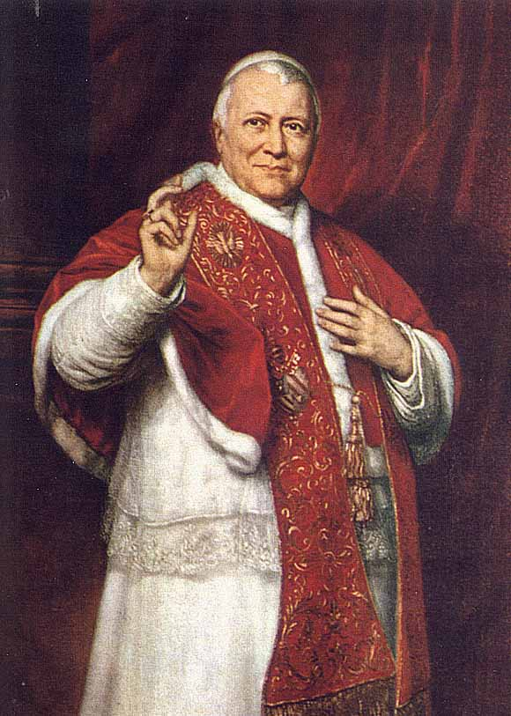
Immaculate Conception ~ 1854, Pope Pius IX
“We declare, pronounce and define that the doctrine which holds that the Blessed Virgin Mary, at the first instant of her conception, by a singular privilege and grace of the Omnipotent God, in virtue of the merits of Jesus Christ, the Saviour of
From 1846-1878
the bondage of Fringe
the

Slide 9
Immaculate Conception ~ 1854, Pope Pius IX
mankind, was preserved immaculate from all stain of original sin, has been revealed by God, and therefore should firmly and constantly be believed by all the faithful.”
the bondage of Fringe
the

Slide 10
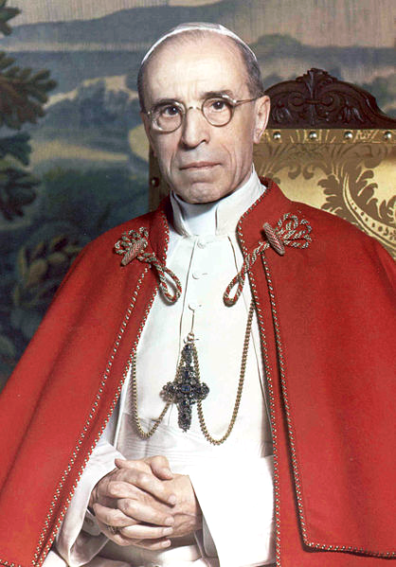
Assumption of Mary ~ 1950, Pope Pius XII
The Virgin Mary “having completed the course of her earthly life, was assumed body and soul into heavenly glory"
2nd Vatican Council (1962-65) declared Mary as the “Mother of the Church”
From 1939-1958
the bondage of Fringe
the

Slide 11
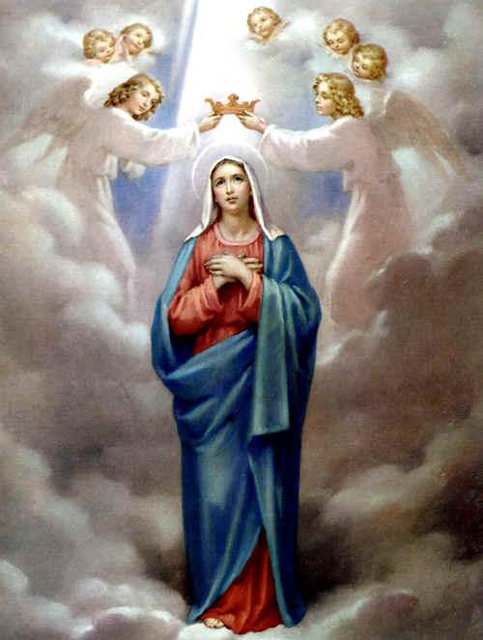
Mediatrix ~ since the 4th century
Vatican II ~ “Taken up to heaven she did not lay aside this saving office but by her manifold intercession continues to bring us the gifts of eternal salvation ... Therefore the Blessed Virgin is invoked in the Church under the titles of Advocate, Helper, Benefactress, and Mediatrix.” (Lumen gentium, 62)
the bondage of Fringe
the

Slide 12
Mediatrix ~ since the 4th century
1 Tim. 2:5 (Douay-Rhiems) ~ For there is one God, and one mediator of God and men, the man Christ Jesus:
the bondage of Fringe
the

Slide 13
1996 Mariological Congress (Co-redemptrix?)
“It is not opportune to abandon the path marked out by the Second Vatican Council and proceed to the definition of a new dogma.”
the bondage of Fringe
the

Slide 14
the bondage of Fringe
the

Slide 15
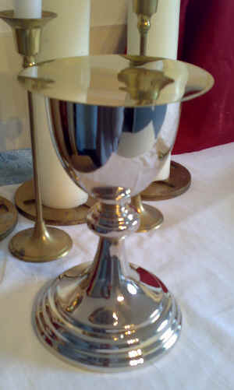
Sacramentalism ~ “Belief in or use of sacramental rites,
acts, or objects;
Specifically : belief that the sacraments are
inherently efficacious
and necessary for
salvation.“
(Merriam-Webster)
the bondage of Fringe
the

Slide 16
1) Baptism
2) Eucharist
3) Penance (or Reconciliation)
4) Confirmation
5) Marriage
6) Ordination
7) Anointing of the Sick
the bondage of Fringe
the

Slide 17
Catechism of the Catholic Church, pg. 1113 ~ “…efficacious signs of grace, instituted by Christ and entrusted to the Church, by which divine life is dispensed to us. The visible rites by which the sacraments are celebrated signify and make present the graces proper to each sacrament. They bear fruit in those who receive them with the required dispositions."
the bondage of Fringe
the

Slide 18
the bondage of Fringe
the

Slide 19
Transubstantiation
The Catholic Catechism (with citations from the Council of Trent) ~ “But the Real Presence is not only different from all the foregoing, It is also unique. It is the physical presence of Christ in your midst, no less truly than he is now present at the right hand of his Father…
the bondage of Fringe
the

Slide 20
Transubstantiation
“… The sacrifice of the altar, then, is no mere empty commemoration of Calvary, but a true and proper act of sacrifice, whereby Christ the high priest by an unbloody immolation (ritual sacrifice) offers himself a most acceptable victim to the eternal Father, as he did on the cross.” (pp. 465-66)
the bondage of Fringe
the

Slide 21
Transubstantiation
“Given this perdurance (long continuance) of Christ's presence as long as the species remain, it was only logical for the Church to worship the Blessed Sacrament as it would the person of Jesus himself. As a result, he is to be adored, ‘in the holy sacrament of the Eucharist with the
the bondage of Fringe
the

Slide 22
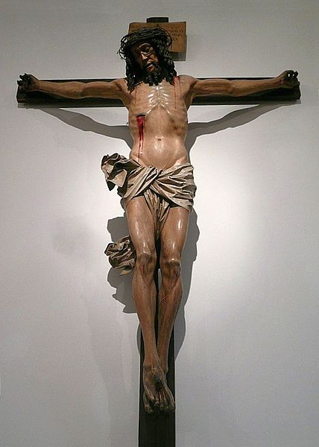
Transubstantiation
worship of latria, including the external worship.’ Concretely this means that the Blessed Sacrament is to be ‘honored with extraordinary festive celebrations’ and ‘solemnly carried from place to place’ and ‘is to be publicly exposed for the people's adoration.’” (pg. 463)
the bondage of Fringe
the

Slide 23
the bondage of Fringe
the

Slide 24

United Pentecostalism
Oneness Pentecostalism
Jesus Only Pentecostalism
the bondage of Fringe
the

Slide 25
the bondage of Fringe
the

Slide 26
Modalism
“The doctrine that the persons of the Trinity represent only three modes or aspects of the divine revelation, not distinct and coexisting persons in the divine nature.”
Also known as “Sabellianism”
the bondage of Fringe
the

Slide 27
the bondage of Fringe
the

Slide 28
“The Father” God of the Old Testament
“The Son” God of the Gospels
“The Holy Spirit”
God of the Church Age
1 AD
Three “Manifestations” of God
the bondage of Fringe
the

Slide 29
Steps to Salvation
1. Hear
2. Believe
3. Repent
Salvation by Faith
4. Confess
5. Baptized in Jesus’ Name
6. Baptized with the Holy Spirit (evidenced by speaking in tongues)
the bondage of Fringe
the

Slide 30
the bondage of Fringe
the

Slide 31
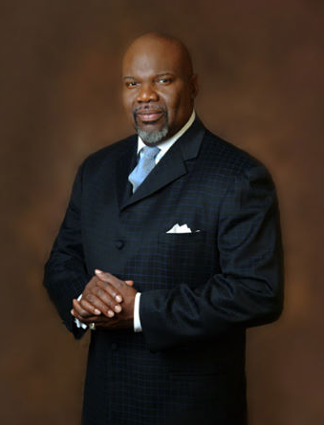
"I'm Trinitarian so long
as I am free to express
it in Sabellian terms."
Bishop T. D. Jakes
the bondage of Fringe
the

Slide 32
Thou shalt not say anything negative about fellow Charismatics
the bondage of Fringe
the

Slide 33
the bondage of Fringe
the

Slide 34
Church of Christ
the bondage of Fringe
the

Slide 35
the bondage of Fringe
the

Slide 36
“We speak where the Bible speaks and we’re silent where the Bible is silent”
the bondage of Fringe
the

Slide 37
the bondage of Fringe
the

Slide 38
Steps to Salvation
1. Hear
2. Believe
Salvation by Faith
3. Repent
4. Confess
5. Baptized for the remission of sins
the bondage of Fringe
the

Slide 39
the bondage of Fringe
the

Slide 40
Baptismal Regeneration ~ the doctrine that regeneration and sanctification are received in and through baptism.
Acts 2:38, 1 Pet. 3:21 and Luke 23:39-43
the bondage of Fringe
the

Slide 41
Act 2:38 ~ Then Peter said to them, “Repent, and let every one of you be baptized in the name of Jesus Christ for the remission of sins; and you shall receive the gift of the Holy Spirit.”
For ~ either with a view towards or because of
the bondage of Fringe
the

Slide 42
You need to reach for the brass ring (with a view towards)
He jumped for joy (because of)
the bondage of Fringe
the

Slide 43

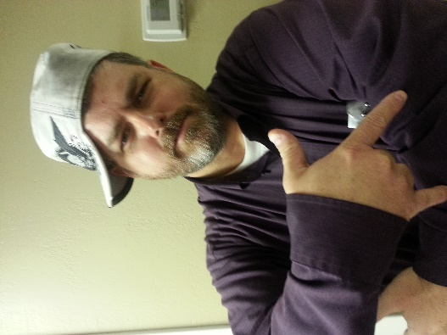
Dastardly Dan
For
Crimes against humanity
Report to the nearest fashion police
the bondage of Fringe
the

Slide 44
the bondage of Fringe
the

Slide 45
1 Pet. 3:21 ~ There is also an antitype which now saves us—baptism (not the removal of the filth of the flesh, but the answer of a good conscience toward God), through the resurrection of Jesus Christ,
the bondage of Fringe
the

Slide 46
Antitype ~ antitupos – a type is the symbol; an antitype is what is symbolized
Tabernacle is the type
Hebrews 8
Heaven is the antitype
Flood waters are the type
1 Peter 3
Baptism is the antitype
the bondage of Fringe
the

Slide 47
from a bad conscience.
Baptism DOES save us –
the bondage of Fringe
the

Slide 48
the bondage of Fringe
the

Slide 49
Luke 23:39-43 ~ the thief on the Cross
the bondage of Fringe
the

Slide 50
the bondage of Fringe
the

